Slide 1

Data Science Fundamentals Final Project LaGuardia Community College Workforce Development Division
Jose Carlo Burga
March 6, 2024

Slide 2

Problem Statement
Strategically located in the heart of the South American Pacific, Peru has become one of the most competitive exporters of Non-Traditional-Farming Products.
Data Source: Peru’s Tax Authority – SUNAT (2022)
1. What are Peru’s Top 10 Farming Exports?
2. Who are Peru’s Top 10 Farming Exporters?
3. Where the Peru’s Top 10 Farming Exports are being produced?
4. What are the logistics of Peru’s Top 10 Farming Exports?
5. Who are Peru’s Exports competitors and potential markets?

Slide 3
What are Peru’s Top 10 farming exports?
What are Peru’s Top 10 Farming Exports
Who are Peru’s Top 10 Farming Exporters? (by product)
Where the Peru’s Top 10 Farming Exports are being produced? (by region)
\
Geolocation shows that most of Peru’s Top 10 Farming Exports are being produced in the northern pacific coast of Peru.
The Province of Viru, in the Lambayeque Region, produces $ 628 Mn in Berries, being the biggest exporting Province in Peru
The District of Chao, in the Lambayeque Region, produces $ 414 Mn in Berries, being the biggest exporting District in Peru
Berries | Grapes | Avocado | Asparagus | Mangoes | Bananas | Onions | Ginger | Tangerines | Artichokes
$ 1.27 Bn | $ 1.06 Bn | $ 1.04 Bn | $ 620 Mn | $ 502 Mn | $ 181 Mn | $ 108 Mn | $ 27 Mn | $ 9.32 Mn | $ 3.49 Mn
Berries | Grapes | Avocado | Asparagus | Mangoes | Bananas | Onions | Ginger | Tangerines | Artichokes
Camposol $ 229 Mn | Rapel $ 160 Mn | Avocado PC $ 117 Mn | Damper $ 39 Mn | Sunshine Exp $ 21 Mn | AG Los Angeles $ 15 Mn | Novoliz $ 16 Mn | AG La Grama $ 6.99 Mn | CP de Fruta $ 10.7 Mn | Alsur $ 3.70 Mn
Berries | Grapes | Avocado | Asparagus | Mangoes | Bananas | Onions | Ginger | Tangerines | Artichokes
La Libertad 763 Mn | Ica 674 Mn | La Libertad 346 Mn | Piura 225 Mn | Piura 225 Mn | Piura 105 Mn | Ica 73 Mn | Junin 58 Mn | Lima 18 Mn | Arequipa 3.78 Mn

Slide 4
What are Peru’s Top 10 farming exports?
What are the logistics of Peru’s Top 10 Farming Exports? 94.26% of Peru’s Top 10 Farming Exports are transported by sea to the following countries:
What are the logistics of Peru’s Top 10 Farming Exports? The Shipping ports used for Peru’s Top 10 Farming Exports are:
What are the logistics of Peru’s Top 10 Farming Exports? The Destination ports for Peru’s Top 10 Farming Exports:
What are Peru’s Top 10 Farming Exports Competitor Ranking?
What are Peru’s Top 10 Farming Exports Potential (purchasing capacity) markets?
USA | Netherlands | Spain | China | UK | Hong Kong | Canada | Mexico | South Korea | Chile
$ 2.12 Bn | $ 999 Mn | $ 281 Mn | $ 253 Mn | $ 242 Mn | $ 195 Mn | $ 90 Mn | $ 87 Mn | $ 84 Mn | $ 78 Mn
Salaverry | Callao (Sea) | Paita | Pisco | Chiclayo | Callao (Air) | Chimbote | Tumbes | Mollendo | Ilo
$ 1.27 Bn | $ 1.06 Bn | $ 1.04 Bn | $ 620 Mn | $ 502 Mn | $ 181 Mn | $ 108 Mn | $ 27 Mn | $ 9.32 Mn | $ 3.49 Mn
Balboa-PN | Posorja-GU | Miami-US | Guayaquil (EC) | Rodman | San Antonio-US | Manzanillo (Mx) | Brooklyn (US) | Cristobal | La Libertad
$ 1.43 Bn | $ 840 Mn | $ 568 MnN | $ 393 Mn | $ 233 Mn | $ 219 Mn | $ 214 Mn | $ 141 Mn | $ 137 Mn | $ 94 Mn
Mexico | Peru | China | Netherlands | Ecuador | Spain | USA | Chile | South Africa | Philippines
$ 5.54 Bn | $ 4.79 Bn | $ 4.63 Bn | $ 4.31 Bn | $ 3.27 Bn | $ 3.08 Bn | $ 2.27 Bn | $ 2.19 Bn | $ 1.74 Bn | $ 1.57 Bn
USA | Netherlands | Germany | UK | China | Canada | France | Russia | Japan | Spain
9.18 Bn | 4.01 Bn | 3.96 Bn | 2.82 Bn | 2. 79 Bn | 2.20 Bn | 1.94 Bn | 1.85 Bn | 1.50 Bn | 1.37 Bn

Slide 5
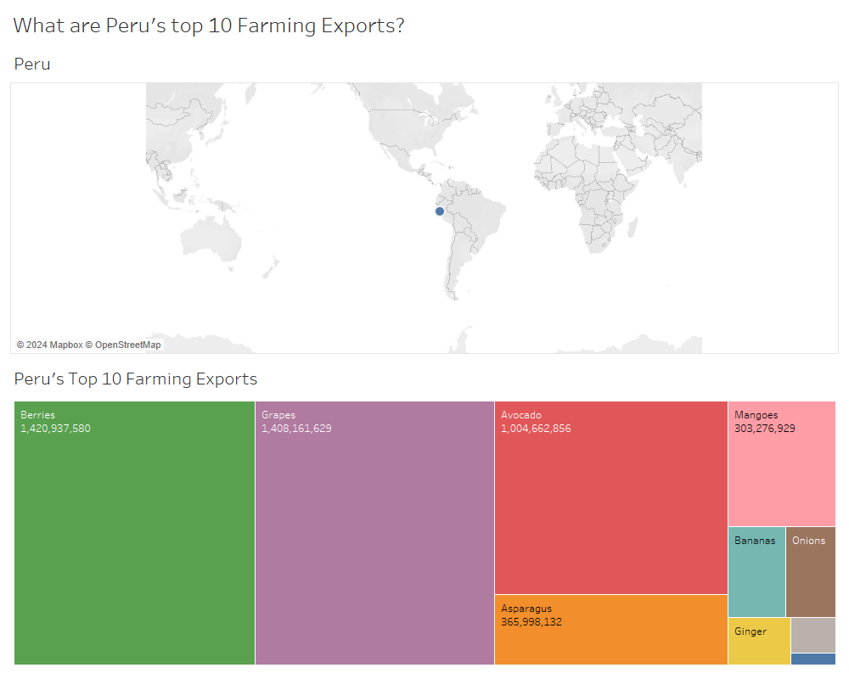

Slide 6
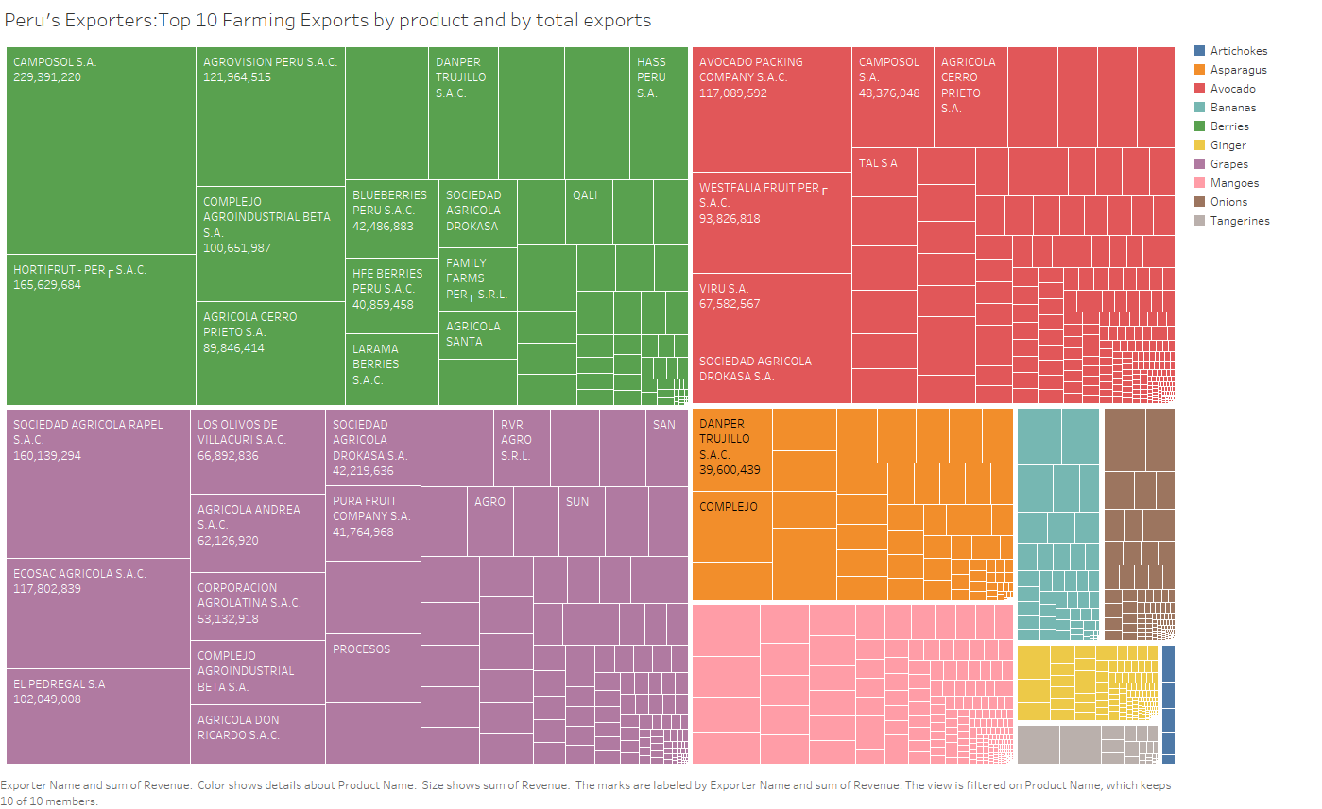

Slide 7
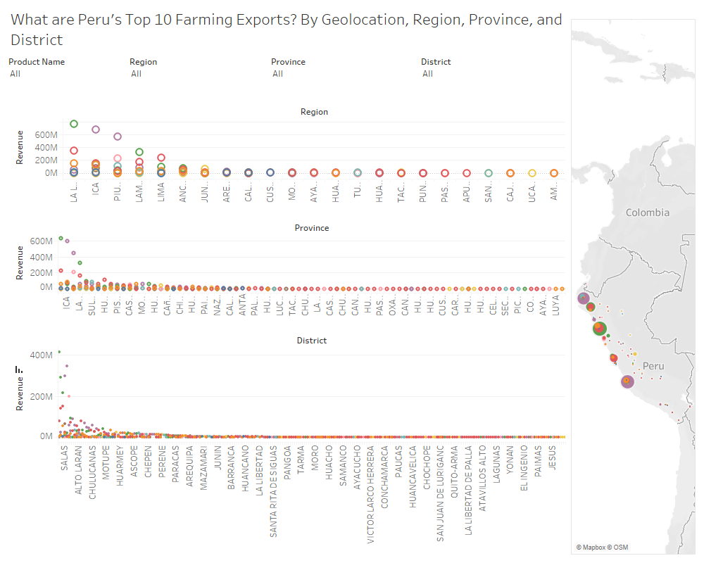

Slide 8
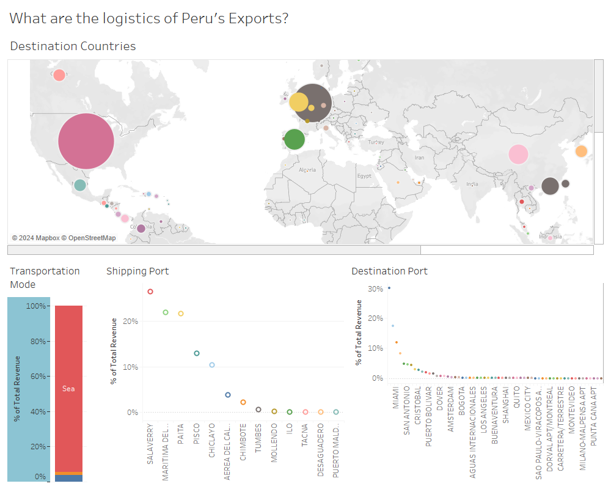

Slide 9
